Slide 1

HTML5 Offline Applications
Kushal Likhi
Daytime: Intelligrape Software
Night Time: Author: groovyMag, jsMag, contributer to open source: grails plugins, openOffice

Slide 2

Agenda
HTML 5 Offline Apps?
Type Of Caches
The Manifest file
Browser Events
Data Storage
Optimization Tool For Existing Apps
Design And Code Analysis Of The Examples
Browser Compatibility

Slide 3
Desktop Vs Web(HTML 4)
.................

Slide 4
Desktop Vs Web(HTML 4)
 | Desktop | HTML 4
Easily Accessible | NO | YES
Fast | YES | NO
Unity Upgrades | NO | YES
Local Data Storage | YES | NO
Internet Connection Mandatory | NO | YES
MVC Client And Data Server | YES | NO

Slide 5
Desktop Vs HTML4 Vs HTML5
 | Desktop | HTML 4 | HTML 5
Easily Accessible | NO | YES | YES
Fast | YES | NO | YES
Unity Upgrades | NO | YES | YES
Local Data Storage | YES | NO | YES
Internet Connection Mandatory | NO | YES | NO
MVC Client And Data Server | YES | NO | YES

Slide 6
HTML 5 Offline Applications Are The Application Which Can Function Even When Offline And Also Provides Us the Ability To Store Data On The Local/User's System.

Slide 7
Why Offline Apps
You could be on a Bus/Train/Plane/etc without a wifi.
You could be at a place with no network signal.
You could be using a buggy internet connection.

Slide 8
Why Local Storage of Data
We need to store user-specefic information, But:
  Cookies are too small (max 4k)
  Cookies are limited (20 in IE)
  Cookies are inefficient as they are sent with each request.

Slide 9
Type Of Caches
HTML 5 CACHE
Resources
Cache
Data
Cache
HTML, CSS, IMAGES, JS etc.
Application database

Slide 10
The Manifest File (Resources Cache)
The mechanism for ensuring Web applications are available even when the user is not connected to their network is the manifest attribute on the html element.
<!DOCTYPE html>
<html lang="en" manifest="/offline.appcache">
// your html document
</html>

Slide 11
The Manifest Attribute
What That Attribute Takes
The attribute takes a URI to a manifest, which specifies which files are to be cached.
Content Type For Manifest
The manifest has a text/cache-manifest MIME type.

Slide 12
The Manifest File(Format)
CACHE MANIFEST
# This is a comment
CACHE:
File entries here
FALLBACK:
<request URL> <cached page>
NETWORK:
File entries here

Slide 13
The Manifest File(Labels)
CACHE
A list of explicit URLs to request and store
FALLBACK
What to do when an offline user attempts to access an uncached file
NETWORK
Which resources are available only while online

Slide 14
Example Of A Manifest File
CACHE MANIFEST
# build 1
CACHE:
/css/screen.css
/css/offline.css
http://example.com/css/styles.css
FALLBACK:
/ /offline.html
/images/profile/display_pic/ /images/default/dp.png
NETWORK:
/feed/onlineUsers.php
*

Slide 15
Invalidating The Manifest
Using the Comments (Version Comment as the best practice)
Firefox Issue:
Firefox caches the manifest itself and never requests it from the server. Hence manifest should be invalidated using the appropiate headers.
<IfModule mod_expires.c>
ExpiresActive On
ExpiresByType text/cache-manifest "access plus 0 seconds"
</IfModule>

Slide 16
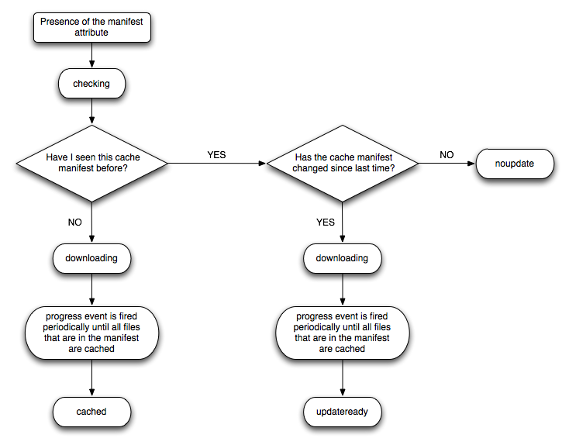
DOM Events

Slide 17
Debugging?
YES Possible.
Developers tools in browsers can assist in that.
Best is in Google chrome

Slide 18
Demo 1
DOM events
Cached Static Site
“Rajnikanth” Site

Slide 19
Data Storage
Data Storage
Relational
No SQL
Direct
WEB
SQL
Local
Storage
Indexed
Storage
File
System
API

Slide 20
Local storage
Is a Key-Value No-Sql datastore.
Ex:
Set value:
localStorage.foo = “bar”
Fetch value:
Var value = localStorage.foo

Slide 21
Session storage
Is a Key-Value volatile datastore.
Has a session scope and exists till browser window is closed.
Ex:
Set value:
sessionStorage.foo = “bar”
Fetch value:
Var value = sessionStorage.foo

Slide 22
Web SQL (Deprecated)
It gives a Structured relational datastore to save our data.
Deprecated. Is not supported on IE and Firefox, and will probably be phased out from the other browsers at some stage.
Hence we will Ignore this datastore.

Slide 23
Indexed Storage (Incubator)
An Indexed Database is a collection of "object stores" which you can just drop objects into.
Asynchronous API
Indexing on basis of keys possible.
Fast and a good future alternative to Web SQL.
Cons:
Complex API
Still not implemented by majority of browsers.

Slide 24
File System API (Still a baby)
We can Read/Write large text/binary files on the user's hard drive.
Cross browser data sharing.
Brings Browser based applications a step closer to desktop applications
Cons:
Only implemented in chrome yet.
In a very early development phase.

Slide 25
The Winner in Data Storage (Today)
Local Storage / Session Storage

Slide 26
Demo 2
To do List
Cross tab communication using calculator.

Slide 27
Optimization Tool For Existing Apps
How can the knowledge we learnt can be used to optimise current web based applications.

Slide 28
Is local Storage Ready?
HTML 5 Local Storage
IE
8.0+
Firefox
3.5+
Safari
4.0+
Chrome
4.0+
Opera
10.5+
IPhone
2.0+
Android
2.0+

Slide 29
Is Resources Cache Ready?
HTML 5 Manifest
IE
9.0+
Firefox
3.6+
Safari
4.0+
Chrome
4.0+
Opera
11+
IPhone
2.0+
Android
3.0+
Updates
Required
4.0+
Full support

Slide 30
Possibilities...
Inter page communication
Message queue. Producer/Consumer
State saving
Auth dialogues.
Cache static resources on the client machine.
Software applications on browser:
  Outlook type email client on browser.

Slide 31
Thankyou

